Slide 1

Feedback Control System Unit 4 Stability

Slide 2
Stability: Definitions
The total response of a system is the sum of the forced and natural responses
A LTI system is stable if the natural response approaches zero as time approaches infinity.
A LTI system is unstable if the natural response grows without bound as time approaches infinity.
A LTI system is marginally stable if the natural response neither decays nor grows but remains constant or oscillates as time approaches infinity.

Slide 3
Stability: Definitions
Therefore, for the stable system only the forced response remains as the natural response approaches zero.
Now if the input is bounded and the total response is not approaching infinity as time approaches infinity, then the natural response is obviously not approaching infinity.
If the input is unbounded, we see an unbounded total response, and we cannot arrive at any conclusion about the stability of the system; we cannot tell whether the total response is unbounded because the forced response is unbounded or because the natural response is unbounded.

Slide 4
Stability: Definitions
Thus, the alternate definition of stability is
A system is stable if every bounded input yields a bounded output.
This is the bounded-input, bounded-output (BIBO) definition of stability.

Slide 5
Stability: Poles locations
How do we determine if a system is stable?
Let us focus on the natural response definitions of stability.
We know the system poles that poles in the left half-plane (lhp) yield either pure exponential decay or damped sinusoidal natural responses.
These natural responses decay to zero as time approaches infinity. Thus, if the closed-loop system poles are in the left half of the plane and hence have a negative real part, the system is stable.
That is, stable systems have closed-loop transfer functions with poles only in the left half-plane.

Slide 6
Stability: Poles locations
Poles in the right half-plane (rhp) yield either pure exponentially increasing or exponentially increasing sinusoidal natural responses.
These natural responses approach infinity as time approaches infinity.
Thus, if the closed-loop system poles are in the right half of the s-plane and hence have a positive real part, the system is unstable.

Slide 7
Stability: Poles locations
The poles of multiplicity greater than 1 on the imaginary axis lead to the sum of responses of the form
At^{n} cos (ωt + Φ), where n = 1; 2; ... ;
which also approaches infinity as time approaches infinity.
Thus, unstable systems have closed loop transfer functions with
at least one pole in the right half-plane and/or
poles of multiplicity greater than 1 on the imaginary axis

Slide 8
Stability: Poles locations
A system that has imaginary axis poles of multiplicity 1 yields pure sinusoidal oscillations as a natural response.
These responses neither increase nor decrease in amplitude.
Thus, marginally stable systems have closed-loop transfer functions with only imaginary axis poles of multiplicity 1 and poles in the left half-plane.

Slide 9
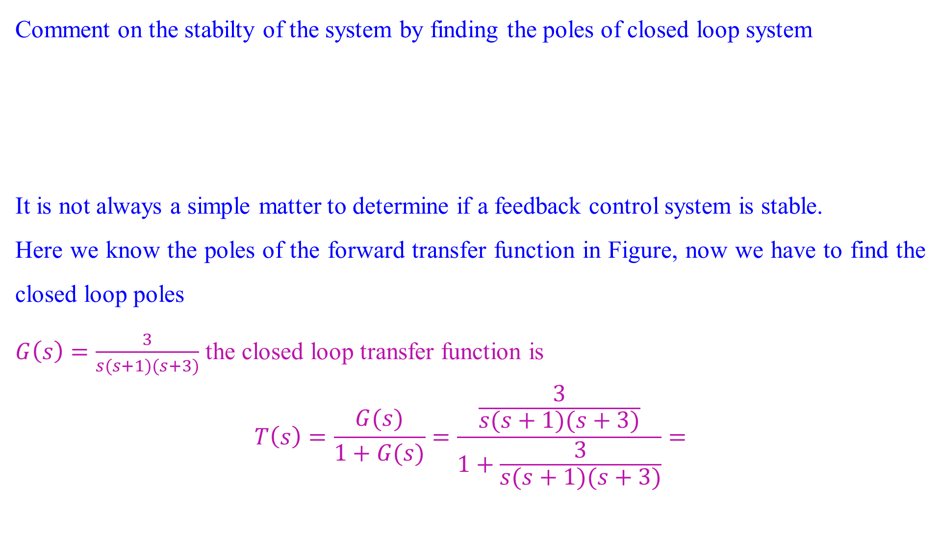
Stability: Poles locations
Comment on the stabilty of the system by finding the poles of closed loop system
It is not always a simple matter to determine if a feedback control system is stable.
Here we know the poles of the forward transfer function in Figure, now we have to find the closed loop poles
$G\left(s\right)=\frac{3}{s(s+1)(s+3)}$ the closed loop transfer function is
$$T\left(s\right)=\frac{G(s)}{1+G(s)}=\frac{\frac{3}{s(s+1)(s+3)}}{1+\frac{3}{s(s+1)(s+3)}}=$$

Slide 10
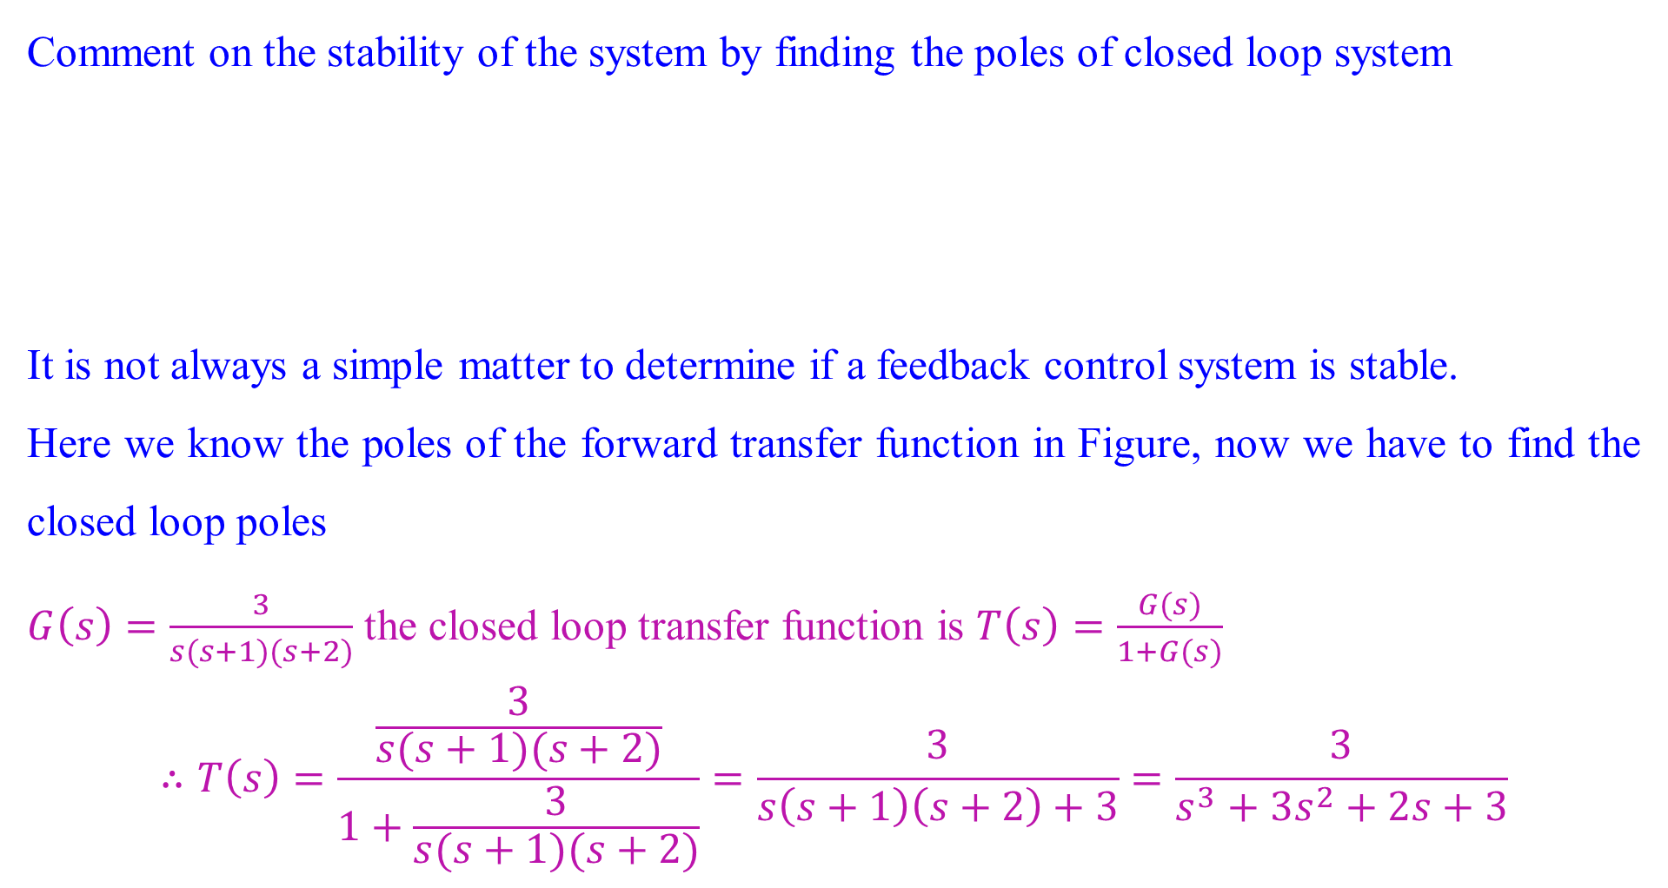
Stability: Poles locations
Comment on the stability of the system by finding the poles of closed loop system
It is not always a simple matter to determine if a feedback control system is stable.
Here we know the poles of the forward transfer function in Figure, now we have to find the closed loop poles
$G\left(s\right)=\frac{3}{s(s+1)(s+2)}$ the closed loop transfer function is $T\left(s\right)=\frac{G(s)}{1+G(s)}$
$$∴T\left(s\right)=\frac{\frac{3}{s(s+1)(s+2)}}{1+\frac{3}{s(s+1)(s+2)}}=\frac{3}{s\left(s+1\right)\left(s+2\right)+3}=\frac{3}{s^{3}+{3s}^{2}+2s+3}$$

Slide 11
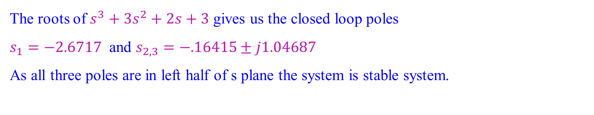
Stability: Poles locations
The roots of $s^{3}+{3s}^{2}+2s+3$ gives us the closed loop poles
$s_{1}=−2.6717$ and $s_{2,3}=−.16415±j1.04687$
As all three poles are in left half of s plane the system is stable system.

Slide 12
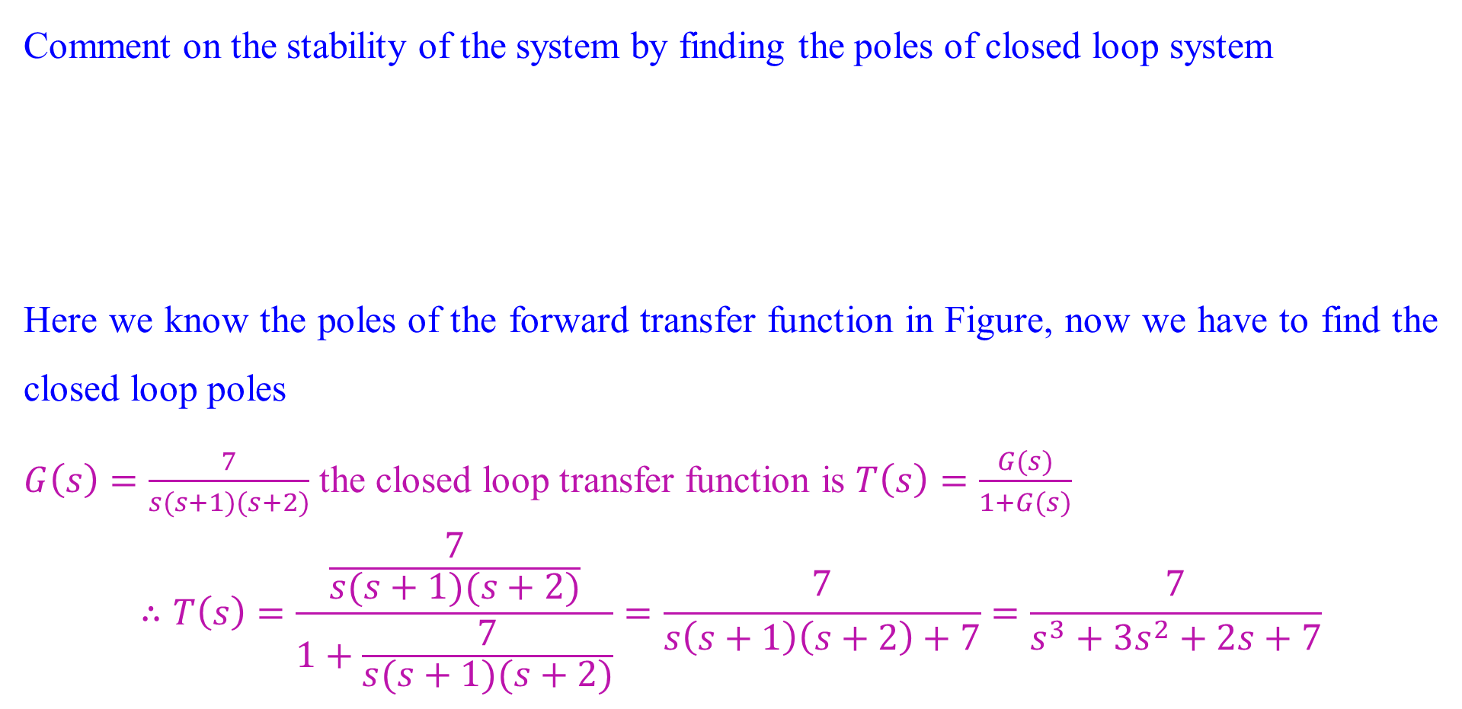
Stability: Poles locations
Comment on the stability of the system by finding the poles of closed loop system
Here we know the poles of the forward transfer function in Figure, now we have to find the closed loop poles
$G\left(s\right)=\frac{7}{s(s+1)(s+2)}$ the closed loop transfer function is $T\left(s\right)=\frac{G(s)}{1+G(s)}$
$$∴T\left(s\right)=\frac{\frac{7}{s(s+1)(s+2)}}{1+\frac{7}{s(s+1)(s+2)}}=\frac{7}{s\left(s+1\right)\left(s+2\right)+7}=\frac{7}{s^{3}+{3s}^{2}+2s+7}$$

Slide 13
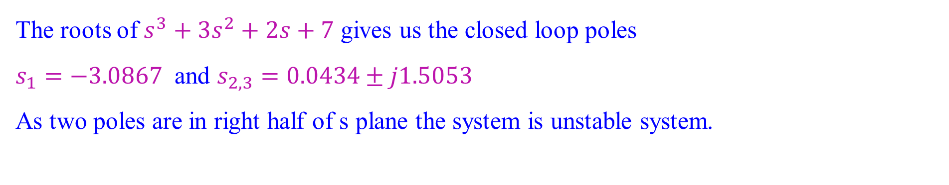
Stability: Poles locations
The roots of $s^{3}+{3s}^{2}+2s+7$ gives us the closed loop poles
$s_{1}=−3.0867$ and $s_{2,3}=0.0434±j1.5053$
As two poles are in right half of s plane the system is unstable system.

Slide 14
Routh-Hurwitz Criterion
This method gives stability information without finding the closed-loop system poles.
Using this method gives us
how many closed-loop system poles are in the left half-plane, in the right half-plane, and on the jω-axis.
Thus, we can find the number of poles in each section of the s-plane, but we cannot find their coordinates.
The method is called the Routh-Hurwitz criterion for stability (Routh, 1905).

Slide 15
Routh-Hurwitz Criterion
The method requires two steps:
Generate a data table called a Routh table and
interpret the Routh table to tell how many closed-loop system poles are inthe left half-plane, the right half-plane, and on the jω-axis.

Slide 16
Routh-Hurwitz Criterion
Consider a system having the closed loop transfer function as shown
We first create the Routh table shown in Table (next slide).
Begin by labeling the rows with powers of s from the highest power of the denominator of the closed-loop transfer function to s⁰
Start with the coefficient of the highest power of s in the denominator and list, horizontally in the first row, every other coefficient.
In the second row, list horizontally, starting with the next highest power of s, every coefficient that was skipped in the first row

Slide 17
Routh-Hurwitz Criterion
Initial layout for Routh table

Slide 18
Routh-Hurwitz Criterion
The remaining entries are filled in as follows.
Each entry is a negative determinant of entries in the previous two rows divided by the entry in the first column directly above the calculated row.
The left-hand column of the determinant is always the first column of the previous two rows, and
the right-hand column is the elements of the column above and to the right.
The table is complete when all of the rows are completed down to s⁰.

Slide 19
Routh-Hurwitz Criterion
Find all the elements of Routh table

Slide 20
Routh-Hurwitz Criterion
Make the Routh table for the system shown in Figure
The first step is to find the equivalent closed-loop system because we want to test locations of the closed loop poles. So, the closed loop system as shown below
Now form the Routh table

Slide 21
Routh-Hurwitz Criterion
First label the rows with powers of s from s³ down to s⁰ in a vertical column,
Next form the first row of the table, using the coefficients of the denominator of the closed-loop transfer function.
Start with the coefficient of the highest power and skip every other power of s.
Now form the second row with the coefficients of the denominator skipped in the previous step.
Subsequent rows are formed with determinants, as discussed.
For convenience, any row of the Routh table can be multiplied by a positive constant without changing the values of the rows below. In this example, 2nd the row was multiplied by 1/10.

Slide 22
Routh-Hurwitz Criterion
Completed Routh table

Slide 23
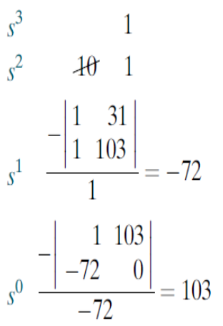
Interpreting the Basic Routh Table
The Routh-Hurwitz criterion declares that
the number of roots of the polynomial that are in the right half-plane is equal to the number of sign changes in the first column.
If the closed-loop transfer function has all poles in the left half of the s-plane, the system is stable. Thus, a system is stable if there are no sign changes in the first column of the Routh table.
In example which we are discussing has two sign changes in the first column.
The first sign change occurs from 1 in the s² row to 72 in the s¹ row.
The second occurs from 72 in the s¹ row to 103 in the s⁰ row.
Thus, the system is unstable since two poles exist in the right half-planey.

Slide 24
Routh Table: Zero Only in the First Column (Epsilon method)
Determine the stability of the closed-loop transfer function
Form the Routh table by using the denominator. Begin by assembling the Routh table down to the row where a zero appears only in the first column (the s³ row).
Next replace the zero by a small number, ε, and complete the table.
To begin the interpretation, we must first assume a sign, positive or negative, for the quantity ε.

Slide 25
Routh Table: Zero Only in the First Column (Epsilon method)
Completed Routh table

Slide 26
Routh Table: Zero Only in the First Column (Epsilon method)
Determining signs in first column of a Routh table with zero as first element in a row

Slide 27
Routh Table: Zero Only in the First Column (Epsilon method)
If ε is chosen positive, table will show a sign change from the s³ row to the s² row, and there will be another sign change from the s² row to the s¹ row.
Hence, the system is unstable and has two poles in the right half-plane.
If ε is chosen negative. Table would then show a sign change from the s⁴ row to the s³ row. Another sign change would occur from the s³ row to the s² row.
So the result would be exactly the same as that for a positive choice for ε.
Thus, the system is unstable, with two poles in the right half-plane

Slide 28
Routh Table: Zero Only in the First Column (Alternative method)
Another method that can be used when a zero appears only in the first column of a row is derived from the fact that
a polynomial that has the reciprocal roots of the original polynomial has its roots distributed the same—right half-plane, left half plane, or imaginary axis—because taking the reciprocal of the root value does not move it to another region.
Thus, if we can find the polynomial that has the reciprocal roots of the original, it is possible that the Routh table for the new polynomial will not have a zero in the first column.
This method is usually computationally easier than the epsilon method just discussed.

Slide 29
Routh Table: Zero Only in the First Column (Alternative method)
We now show that the new polynomial (the one with the reciprocal roots) is simply the original polynomial with its coefficients written in reverse order.
Assume the equation.
…1
If s is replaced by 1/d, then d will have roots which are the reciprocal of s. Making this substitution in Eq. (1)
…2
Factoring out (1/d)^{n}

Slide 30
Routh Table: Zero Only in the First Column (Alternative method)
…3
Thus, the polynomial with reciprocal roots is a polynomial with the coefficients written in reverse order.

Slide 31
Routh Table: Zero Only in the First Column (Alternative method)
Determine the stability of the closed-loop transfer function
First write a polynomial that has the reciprocal roots of the denominator of T(s). This polynomial is formed by writing the denominator of T(s) in reverse order.
Hence

Slide 32
Routh Table: Zero Only in the First Column (Alternative method)
Routh table
Since there are two sign changes, the system is unstable and has two right-half-plane poles. This is the same as the result obtained before by the epsilon method.

Slide 33
Routh Table: Entire Row is Zero
Determine the number of right-half-plane poles in the closed-loop transfer function
The Routh table is

Slide 34
Routh Table: Entire Row is Zero
At the second row we multiply through by 1/7 for convenience.
We stop at the third row, since the entire row consists of zeros, and use the following procedure. First we return to the row immediately above the row of zeros and form an auxiliary polynomial, using the entries in that row as coefficients.
The polynomial will start with the power of s in the label column and continue by skipping every other power of s. Thus, the polynomial formed for this example is
Next we differentiate the polynomial with respect to s and obtain
…1

Slide 35
Routh Table: Entire Row is Zero
Use the coefficients of Eq. (1) to replace the row of zeros.
Again, for convenience, the third row is multiplied by 1/4 after replacing the zeros.
The remainder of the table is formed in a straightforward manner by following the standard procedure. Table shows that all entries in the first column are positive. Hence, there are no right–half-plane poles.

Slide 36
Routh Table: Entire Row is Zero
An entire row of zeros:
An entire row of zeros will appear in the Routh table when a purely even or purely odd polynomial is a factor of the original polynomial.
For example, s⁴ + 5s² + 7 is an even polynomial; it has only even powers of s. Even polynomials only have roots that are symmetrical about the origin.
The polynomial s⁵ + 5s³ + 7s is an example of an odd polynomial; it has only odd powers of s. Odd polynomials are the product of an even polynomial and an odd power of s. Thus, the constant term of an odd polynomial is always missing.

Slide 37
Routh Table: Entire Row is Zero
An entire row of zeros:
The roots are symmetrical and real,
the roots are symmetrical and imaginary, or
the roots are quadrantal.
Each case or combination of these cases will generate an even polynomial.

Slide 38
Routh Table: Entire Row is Zero
A: Real and symmetrical about the origin
B: Imaginary and symmetrical about the origin
C: Quadrantal and symmetrical about the origin

Slide 39
Routh Table: Entire Row is Zero
An entire row of zeros:
The roots are symmetrical and real,
the roots are symmetrical and imaginary, or
the roots are quadrantal.
Each case or combination of these cases will generate an even polynomial.

Slide 40
Routh Table: Entire Row is Zero
It is this even polynomial that causes the row of zeros to appear.
Thus, the row of zeros tells us of the existence of an even polynomial whose roots are symmetric about the origin.
Some of these roots could be on the jω-axis. On the other hand, since jω roots are symmetric about the origin, if we do not have a row of zeros, we cannot possibly have jω roots.
Another characteristic of the Routh table is that the row previous to the row of zeros contains the even polynomial that is a factor of the original polynomial.
Finally, everything from the row containing the even polynomial down to the end of the Routh table is a test of only the even polynomial.

Slide 41
Routh Table: Entire Row is Zero
For the transfer function find how many poles are in the right half-plane, in the left half-plane, and on the jω-axis.
Use the denominator and form the Routh table
For convenience the s⁶ row is multiplied by 1/10, and
the s⁵ row is multiplied by 1/20.

Slide 42
Routh Table: Entire Row is Zero
Routh Table

Slide 43
Routh Table: Entire Row is Zero
At the s³ row we obtain a row of zeros. Moving back one row to
s⁴, we extract the even polynomial, P(s), as P(s) = s⁴ + 3s² + 2
This polynomial will divide evenly into the denominator and thus is a factor. Taking the derivative with respect to s to obtain the coefficients that replace the row of zeros in the s³ row, we find dP(s)/ds = 4s³ + 6^{s} +0
Replace the row of zeros with 4, 6, and 0 and multiply the row by 1/2 for convenience. Finally, continue the table to the s⁰ row, using the standard procedure.

Slide 44
Routh Table: Entire Row is Zero
At the s³ row we obtain a row of zeros. Moving back one row to
s⁴, we extract the even polynomial, P(s), as P(s) = s⁴ + 3s² + 2
This polynomial will divide evenly into the denominator and thus is a factor. Taking the derivative with respect to s to obtain the coefficients that replace the row of zeros in the s³ row, we find dP(s)/ds = 4s³ + 6^{s} +0
Replace the row of zeros with 4, 6, and 0 and multiply the row by 1/2 for convenience. Finally, continue the table to the s⁰ row, using the standard procedure.

Slide 45
Routh Table: Entire Row is Zero
Interpretation
Since all entries from the even polynomial at the s⁴ row down to the s⁰ row are a test of the even polynomial,
we begin to draw some conclusions about the roots of the even polynomial.
No sign changes exist from the s⁴ row down to the s⁰ row.
Thus, the even polynomial does not have right–half-plane poles. Since there are no right–half-plane poles, no left–half-plane poles are present because of the requirement for symmetry. Hence, the even polynomial must have all four of its poles on the jω-axis.

Slide 46
Routh Table: Entire Row is Zero
Polynomial
Location | Even (fourth order) | Other (fourth order) | Total (Eight Order)
Right half plane | 0 | 2 | 2
Left half plane | 0 | 2 | 2
jω | 4 | 0 | 4
.

Slide 47
Routh Table: Numerical
Find the number of poles in the left half-plane, the right half-plane, and on the jω-axis for the system
First, find the closed-loop transfer function as
Routh Table

Slide 48
Routh Table: Numerical
Routh Table
At the s₁ row there is a negative coefficient; thus, there are two sign changes. The system is unstable, since it has two right–half plane poles and two left–half-plane poles.
The system cannot have jω poles since a row of zeros did not appear in the Routh table.

Slide 49
Routh Table: Numerical
Find the number of poles in the left half-plane, the right half-plane, and on the jω-axis for the system
The closed-loop transfer function is
A zero appears in the first column of the s³ row.
Since the entire row is not zero, simply replace the zero with a small quantity, ε, and continue the table. Permitting ε to be a small, positive quantity, we find that the first term of the s² row is negative. Thus, there are two sign changes, and the system is unstable, with two poles in the right half-plane. The remaining poles are in the left half-plane

Slide 50
Routh Table: Numerical
Routh Table
A zero appears in the first column of the s³ row.
Since the entire row is not zero, simply replace the zero with a small quantity, ε, and continue the table. Permitting ε to be a small, positive quantity, we find that the first term of the s² row is negative. Thus, there are two sign changes, and the system is unstable, with two poles in the right half-plane. The remaining poles are in the left half-plane.

Slide 51
Routh Table: Numerical
We also can use the alternative approach, where we produce a polynomial whose roots are the reciprocal of the original.
polynomial by writing the coefficients in reverse order

Slide 52
Routh Table: Numerical
Find the number of poles in the left half-plane, the right half-plane, and on the jω-axis for the system of Figure 6.8. Draw conclusions about the stability of the closed-loop system
The closed-loop transfer function for the system is
Using the denominator, form the Routh table. A row of zeros appears in the s⁵ row. Thus, the closed-loop transfer function denominator must have an even polynomial as a factor. Return to the s⁶ row and form the even polynomial.

Slide 53
Routh Table: Numerical
Routh table

Slide 54
Routh Table: Numerical
Differentiate this polynomial with respect to s to form the coefficients that will replace the row of zeros.
Replace the row of zeros at the s⁵ row by the coefficients of above equation and multiply through by 1/2 for convenience. Then complete the table.
We note that there are two sign changes from the even polynomial at the s⁶ row down to the end of the table. Hence, the even polynomial has two right–half plane poles. Because of the symmetry about the origin, the even polynomial must have an equal number of left–half-plane poles. Therefore, the even polynomial has two left–half-plane poles. Since the even polynomial is of sixth order, the two remaining poles must be on the jω-axis.

Slide 55
Routh Table: Numerical
There are no sign changes from the beginning of the table down to the even polynomial at the s⁶ row. Therefore, the rest of the polynomial has no right–half plane poles.
The system has two poles in the right half-plane, four poles in the left half-plane, and two poles on the jω-axis, which are of unit multiplicity. The closed-loop system is unstable because of the right–half-plane poles
Polynomial
Location | Even (sixth order) | Other (fourth order) | Total (Eight Order)
Right half plane | 2 | 0 | 2
Left half plane | 2 | 2 | 4
jω | 2 | 0 | 2

Slide 56
Routh Table: Numerical
Find the range of gain, K, for the system that will cause the system to be stable, unstable, and marginally stable. Assume K > 0.
First find the closed-loop transfer function as
Routh Table

Slide 57
Routh Table: Numerical
Since K is assumed positive, we see that all elements in the first column are always positive except the s¹ row. This entry can be positive, zero, or negative, depending upon the value of K. If K < 1386, all terms in the first column will be positive, and since there are no sign changes, the system will have three poles in the left half-plane and be stable.
Routh Table

Slide 58
Routh Table: Numerical
If K > 1386, the s¹ term in the first column is negative. There are two sign changes, indicating that the system has two right–half-plane poles and one left–half-plane pole, which makes the system unstable.
Routh Table

Slide 59
Routh Table: Numerical
If K = 1386, we have an entire row of zeros, which could signify jω poles. Returning to the s² row and replacing K with 1386, we form the even polynomial
Differentiating with respect to s, we have
Replacing the row of zeros with the coefficients, we obtain the modified Routh Hurwitz table for the case of K = 1386
Routh Table

Slide 60
Routh Table: Numerical
Routh Table
Since there are no sign changes from the even polynomial (s² row) down to the bottom of the table, the even polynomial has its two roots on the jω-axis of unit multiplicity.
Since there are no sign changes above the even polynomial, the remaining root is in the left half-plane. Therefore, the system is marginally stable.

